Slide 1

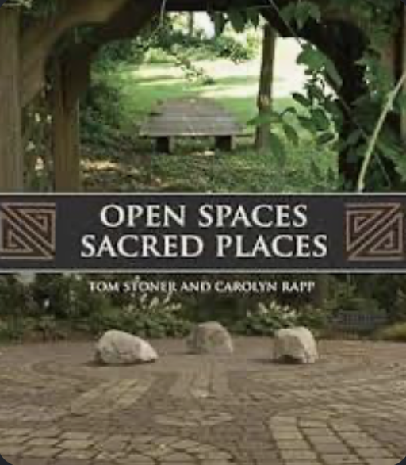
Nature Sacred Timeline: External
1996
TKF Foundation founded by Kitty & Tom Stoner, as a private grant-giving foundation
2008
Open Spaces, Sacred Places published
2012
2018
Firesoul Network founded
2020
Official rebranded to Nature Sacred and shift to operating foundation
2019
30+ Articles published funded by TKF
100 Sacred Places open
2022
Celebrated 25 years
BenchTalk published
2023
Pascal Mittermaier named as Board Chair
2025
Successful completion of Nature Sacred's strategic plan
Launched Nature Sacred National Awards Program
First Sacred Place Grand Opening: Inspiration Point at the Chesapeake Bay Foundation HQ, Annapolis, MD
Sacred Place Opened at Mount Street Gardens (London, UK), the place that inspired the Co-Founders, in honor 30 years of impact
Formed an Independent Board
Launched first strategic plan as an operating foundation
200 Sacred Places open or in development
2026
Launched Finding A Better Way: Accelerating Belonging Through Nature strategic plan
Possible Light the Labyrinth event
NS Logo debuted
Inspo point photo or co-founders in Mt. Street
FABW plan image

